Slide 1

Softmax Hot-Encoding Multi-output NNs Cross-Entropy Loss
Gates

Slide 2
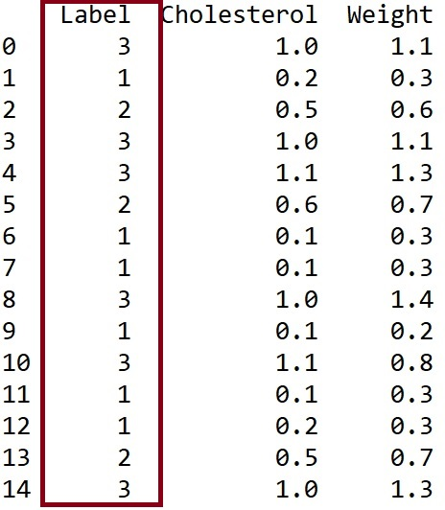
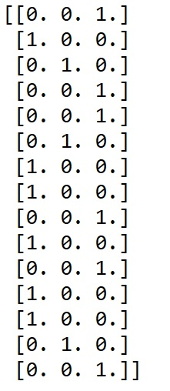
One Hot Encoding
temp = y ## Actual labels
#print(temp)
one_hot_labels = np.zeros((n, NumberOfLabels))
#print(one_hot_labels)
for i in range(n):
one_hot_labels[i, temp[i]-1] = 1
#print(one_hot_labels)
y = one_hot_labels
print(y)

Slide 3
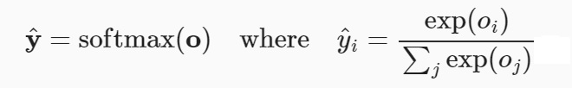
What is the Softmax function?
1) Also called softargmax.
2) Normalized exponential function.
3) Converts a vector of k real numbers into a probability distribution of k probabilities that all sum to 1.
4) Can also be used in multinomial logistic regression.
5) Often used as the last activation function of a neural network
6) It is a “smooth” approximation to the argmax

Slide 4
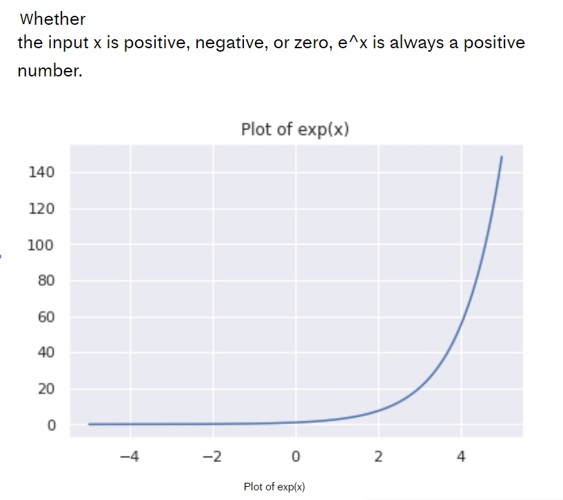
Plot of e^x

Slide 5
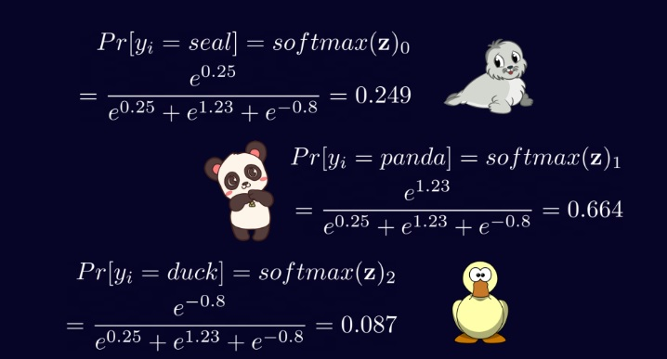
Example
Suppose you are using a NN to predict three possible categories: Seal, Panda, Duck
Suppose the NN predicts
[0.25, 1.23, -0.8 ]
The softmax will normalize the outputs so that the result both sums to 1 and offers the largest result.

Slide 6
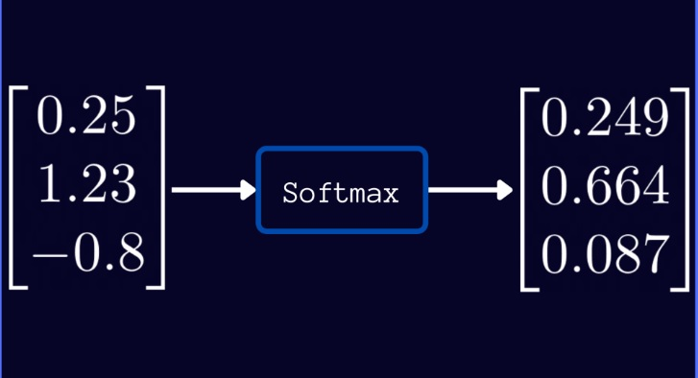
Softmax Outputs
1) The raw outputs (left) do not offer a probability of accuracy.
2) The normalized softmax offers a probability distribution that sums to 1 and gives a probability of each output.
3) One can then use argmax on the softmax results for the final prediction.

Slide 7
What is the Cross-Entropy Loss Function?
1) Cross-entropy (from the field of information theory) calculates the difference between two probability distributions.
2) Specifically, and different from KL divergence, cross-entropy calculates the total entropy between the distributions.
3) Interesting Note: Cross entropy is not the same as log-loss. However, when used as loss functions, both measures calculate the same quantity.

Slide 8
Definitions and Details
Cross-entropy builds upon the idea of entropy from information theory.
Can be used to compare distributions.
Information h(x) can be calculated for an event x, given the probability of the event P(x) as follows:
h(x) = -log(P(x))
Entropy
The entropy, H(x), for a random variables with a set x in X (discrete) with P(x) as the probability of each x is defined as:
H(x) = -SUM (over all x in X) P(x) * log(P(x)

Slide 9
Cross Entropy of P and Q
Consider a target distribution P and an approximation of the target distribution Q.
(You can think of this as Y and Y^ assuming each are converted to probability distributions)
Then, the cross-entropy between P and Q is:
H(P, Q) = – sum (x in X) P(x) * log(Q(x)) //the log is base 2 or e

Slide 10
Example
from math import log2
import numpy as np
# calculate cross entropy
def cross_entropy(p, q):
return -sum([p[i]*log2(q[i]) for i in range(len(p))])
Y = [1, 0, 0]
Yhat = [0.80, 0.15, 0.05]
CrossEntropy_Y_Yhat = cross_entropy(Y, Yhat)
print(CrossEntropy_Y_Yhat)
Suppose you have three possible outcomes/labels, say 1, 2, and 3
(like bird, fish, mammal)
Next, suppose you have:
Y = [1, 0, 0]
Y^ = [0.80, 0.15, 0.05]
print(CrossEntropy_Y_Yhat)
0.3219280948873623

Slide 11
Example 2
def cross_entropy(p, q):
return -sum([p[i]*log2(q[i]) for i in range(len(p))])
Y = [1, 0, 0]
#Yhat = [0.80, 0.15, 0.05]
Yhat = [1, 0.0000000000001, 0.000000000001]
CrossEntropy_Y_Yhat = cross_entropy(Y, Yhat)
print(CrossEntropy_Y_Yhat)
What if Y and Y^ are the same?
Y = [1, 0, 0]
Y^ = [1, 0, 0]
print(CrossEntropy_Y_Yhat)
0.0
Notice the 0.000000000001

Slide 12
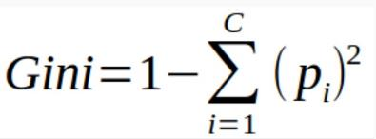
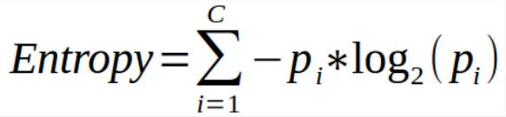
GINI and Entropy

Slide 13
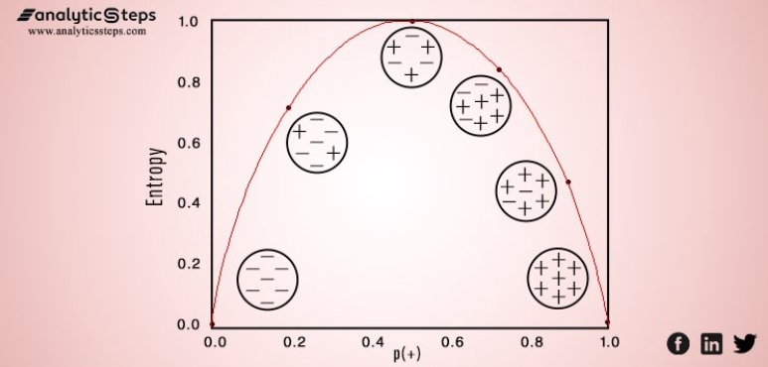
Entropy Visually

Slide 14

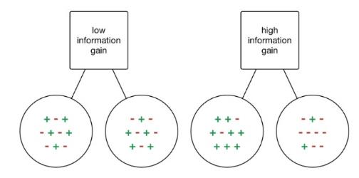
Information Gain
Information gain is a measure quantifies how much a given “tree node split” unmixes the labels at a node.
Mathematically it is measure of the difference between impurity values before splitting the data at a node and the weighted average of the impurity after the split.
Here – this works using GINI in the same way.

Slide 15
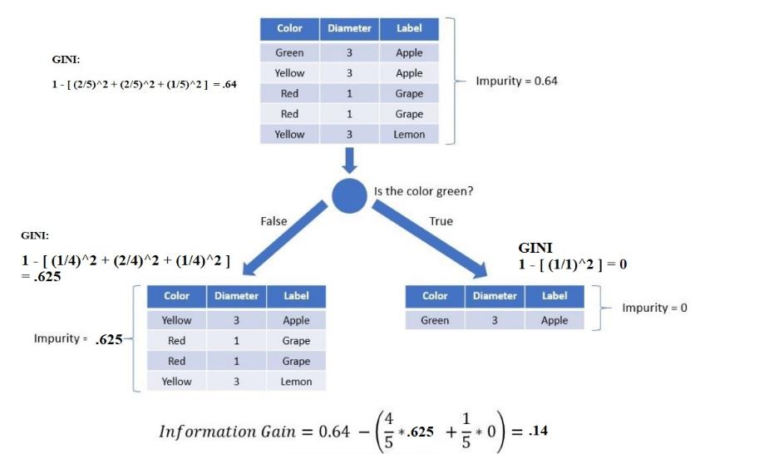
Example 1

Slide 16
Calculate Entropy for Class Labels
Recall that when two distributions are identical, the cross-entropy between them is equal to the entropy for the probability distribution.
If we are using one-hot encoding, the entropy for any Y is 0 because there is no information in [ 1 0 0] for example.
STEPS:
1) One-Hot Encode the Label (Y) of the Dataset
2) Use Softmax to update all predicted outcomes (Y^) so that each is a probability distribution that sums to 1.
3) Use Cross Entropy to measure the “error/loss” between Y and Y^. If the error/loss is “0”, then the prediction is perfect.
4) When using a batch of inputs at a time – we will need to AVERAGE…

Slide 17
Gut Values for Cross Entropy
Cross-Entropy = 0.00: Perfect probabilities.
Cross-Entropy < 0.02: Great probabilities.
Cross-Entropy < 0.05: On the right track.
Cross-Entropy < 0.20: Fine.
Cross-Entropy > 0.30: Not great.
Cross-Entropy > 1.00: Terrible.
Cross-Entropy > 2.00 Something is broken.

Slide 18
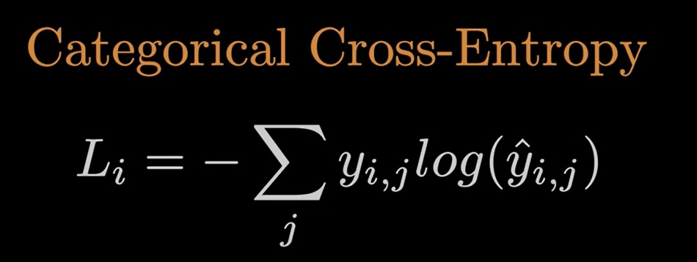
Li is the sample loss value
i is the ith sample in the dataset
j is the label index
y is the target
y^ is the prediction
We can simplify this formula because our Y is encoded using one hot encoding

Slide 19
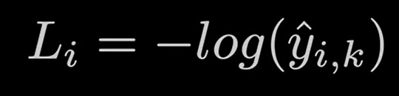
Simplified Version of Cross Entropy Function
Li is the sample loss value
i is the ith sample in the
k is the index of the correct class probability
Here – “log” is assumed to be log base e – the natural log

Slide 20
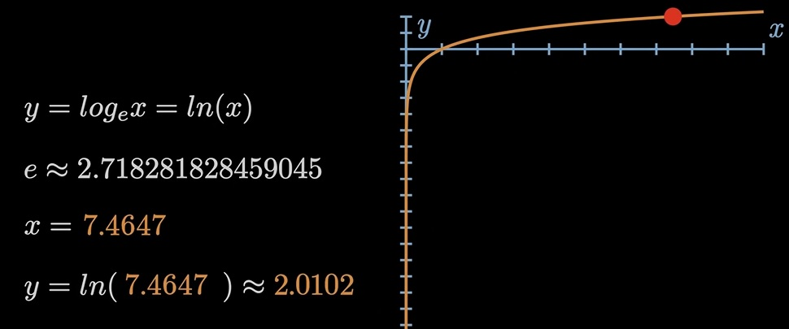
Log_e Function

Slide 21
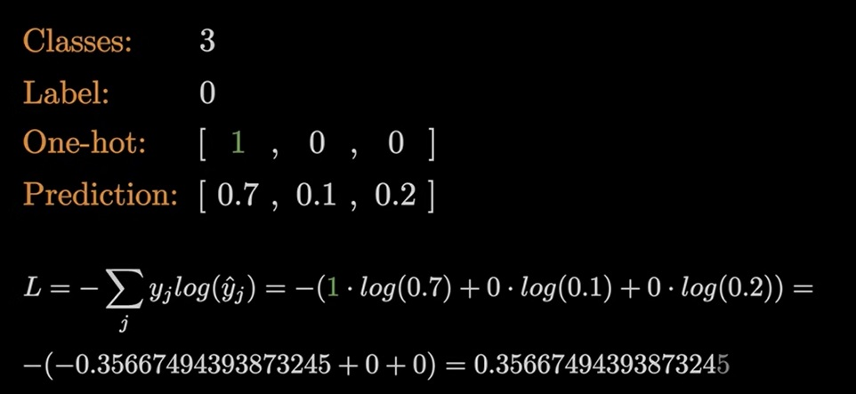

Slide 22
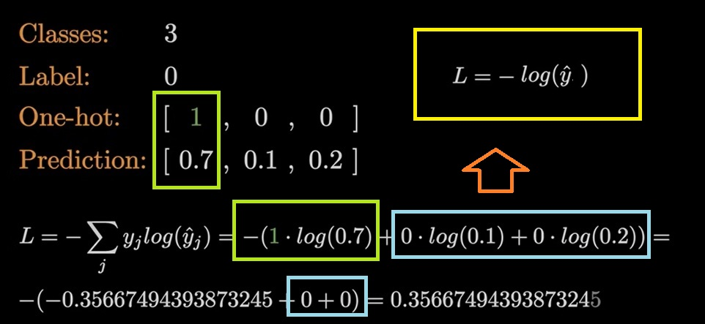

Slide 23
Loss Function:

Slide 24
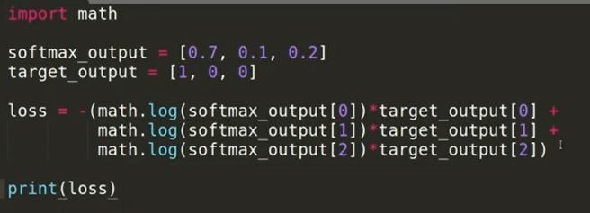
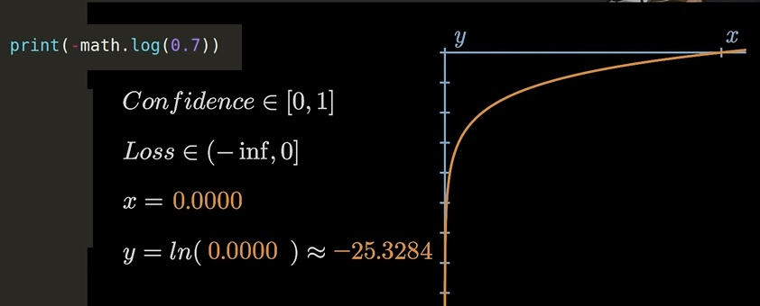

Slide 25
Entropy Cross Entropy Log Loss
Cross Entropy

Slide 26
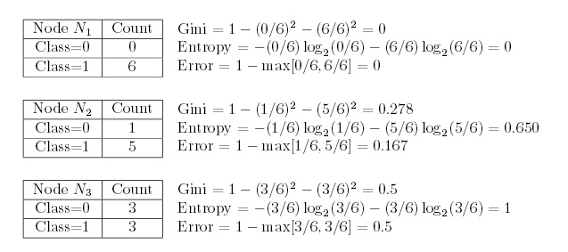
General Entropy – Such as for Decision Tree Node Splitting
which has lowest impurity?
Which has highest impurity?

